Slide 1

CONCRETE
ARCHITECTURE
Bitcoin Core
Pereira D, Susilo A, Shrestha K
Bridson-Boyczuk A, Fung C, Wuthrich I
CISC 322 W22 Professor Bram Adams
24/03/2023

Slide 2
Team FTX
Devin Pereira
Alex Susilo
Kanchan Shrestha
Cyrus Fung
Adlai Bridson-Boyczuk
Isaiah Wuthrich
01
02
Presenter
Mining
Wallet
Util
App
Connection Manager
Limitation & Lessons Learned
Presentation Aesthetics
03
04
Team Lead
Use Cases/Diagrams
Low Level Reflexion Analysis
Introduction
Low-level overview
Explanations for Mining subsystem components
05
06
Presenter
Low Level Reflexion Analysis
Low level overview for policy
Validation Engine
Storage Engine
Mempool

Slide 3
Introduction
Perform Reflexion Analysis to evaluate the actual system & our conceptual architecture
Inspect the low-level functioning of Mining to get a deeper understanding of its operation
8 main components: - Mining, Wallet, Validation Engine, Storage Engine, Mempool, Connection Manager, App, Util
Layered architecture for nodes, with each individual node connected in a peer-to-peer fashion

Slide 4
Derivation Process
01
02
03
04
Create
Analyze
Adjust
Repeat
Assign all the files and make first draft of Concrete Architecture
Analyze the dependencies and look for gaps
Rectify gaps by making changes to the mapping of files or the Architecture
Repeat steps 2 and 3 until result is satisfactory

Slide 5
High-Level Architecture

Slide 6
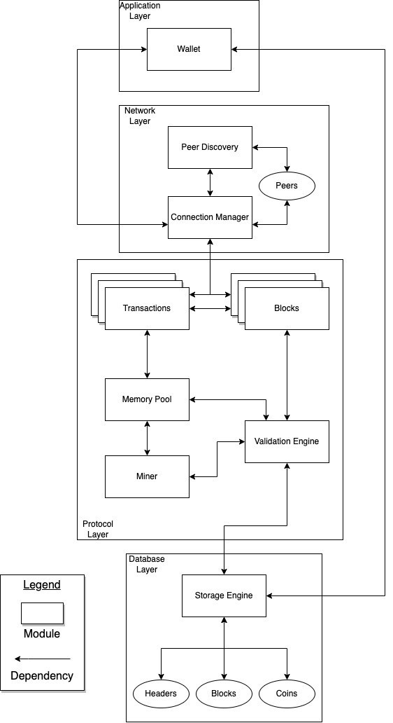
Conceptual Architecture

Slide 7
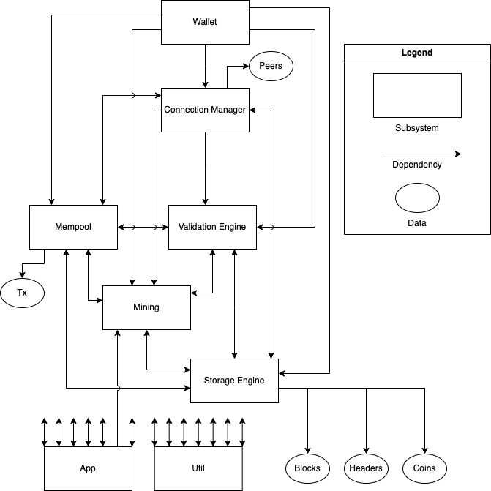
Concrete Architecture

Slide 8
Mining
01
02
03
04
Verify Tx
Proof-of-work
Share
Reward
Verifies Tx and stores them in Mempool
Proof-of-work is solved and is block formed with Tx taken from Mempool
Block is added to the blockchain and sent to peers
Miner compensated with bitcoin
Reflexion
Bi-directional connection with Storage Engine

Slide 9
Wallet
Tracks and controls
Signs
Synch Tx history with
Create Apps
Reflexion
Unidirectional connection with Connection Manager
Unidirectional connection with Storage Engine

Slide 10
Util
Data Serialization
Network Communication
Cryptographic Operations
Problem:
Bi-directional connections with all other components

Slide 11
Validation Engine
Validates
Reflexion
Connection Manager and Wallet now rely on this module
New bidirectional dependencies with App and Util
Transactions
Blocks
Sent to Mempool to await confirmation.
Validates Proof-of-Work and adheres to consensus rules

Slide 12
Storage Engine
Reflexion
New bidirectional dependencies:
Mempool
Mining
Connection Manager
App
Util
No longer relies on Wallet
Blocks no longer its own module
Blockchain
UTXO
Storing
Indices
Wallet info
Notes:
New bidirectional dependencies:
Mempool
Mining
Connection Manager
App
Util

Slide 13
Mempool
Stores verified transactions from Validation Engine that awaiting confirmation
Reflexion
New bidirectional dependencies:
Connection Manager
Storage Engine
App
Util
Transactions now a data type in Mempool
Notes:
New bidirectional dependencies:
Connection Manager
Storage Engine
App
Util

Slide 14
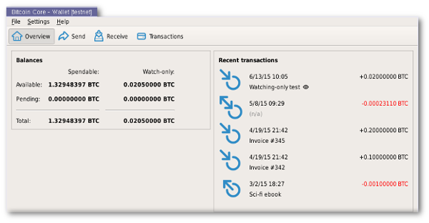
App
Reflexion
Not in initial conceptual architecture
Robust and extensible architecture
Bi-directional Dependencies:
EVERYTHING
Cohesive and functional system
Ensures evolution and adaptation
Logic, Functionality, Control Flow
Core logic and functionality
Main entry point for software
Primary control flow for sub-systems
Modular Design
Pluggable features/extensions
Easier to develop
Easier to maintain
UI Components
Interact with software
Graphical interfaces
Command-line interfaces

Slide 15
Connection Manager
Reflexion
Peer Discovery Merged
Transaction & Blocks → Forms of Data
Stored in Mempool & Storage Engine
Bi-directional Dependencies:
Mempool
Storage Engine
App
Util
Uni-directional Dependencies:
Wallet
Validation Engine
Miner
Peer Discovery
Synchronization
Transmission Management
Network Partitioning
Notes:
The Connection Manager sub-system is critical to the Bitcoin network, ensuring that all nodes can communicate with each other. The sub-system establishes and maintains connections with other peer nodes, manages the transmission and receipt of network messages, handles synchronization of the Bitcoin blockchain across nodes, and manages bandwidth usage by prioritizing network traffic and limiting established connections.
However, investigating the gaps between architectures, there were significant differences in the Connection Manager sub-system. Peer Discovery now falls under the Connection Manager, while Transactions and Blocks are stored in other sub-systems.
The Connection Manager features new dependencies. It has a bi-directional dependency with sub-systems such as Mempool, Storage Engine, App and Util while also having uni-directional dependencies with Wallet, Validation Engine, and Miner. Please note that this is summarized.

Slide 16
Low-Level Architecture
Mining

Slide 17

Overview: Mining
Responsible for minting new Bitcoins, validating transactions and updating state of blockchain
Both conceptual and concrete architecture follow a pipe and filter style
Conceptual architecture: Blocks flow from Block Propagation/Creation to Validation, Reward, Selection, and Solver.
Concrete architecture: Subcomponents include Miner, Proof of Work, Consensus, Policy, and Merkleblock.
Architectures were derived from internal developer docs on GitHub and created using Understand to analyze source code.

Slide 18
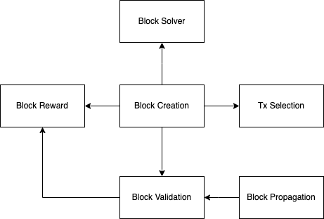
Conceptual Architecture

Slide 19
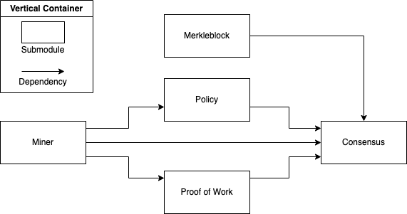
Concrete Architecture

Slide 20
Miner
Base of Miner Subsystem
Is one of the source filters in the pipe and filter style
Corresponds to Block Creation in conceptual architecture
Block Solver, Validation, Reward and Transaction Selection all depend on Miner in conceptual architecture
Reflection analysis:
No new dependencies in concrete architecture

Slide 21
Merkleblock
One of the first filters in the subsystem
Merkle blocks enable efficient validation of Bitcoin transactions without downloading the entire block
Corresponds to Block Propagation in conceptual architecture
Merkle blocks are passed to Block Validation, also known as Consensus.
Reflection analysis:
New outgoing dependency on Storage Engine
New incoming dependencies on Wallet and Connection Manager

Slide 22
Consensus
Implements the consensus mechanism of Bitcoin
Handles both validation of incoming Merkle blocks and minting of new Bitcoins as rewards for miners
Corresponds with Block Reward and Block Validation
Data from Merkleblock, Policy, and Proof of Work are piped into Consensus
Reflection analysis:
New incoming dependency with Policy (Transaction Selection) added

Slide 23
Policy
Enforces rules and constraints in the mining subsystem of Bitcoin Core
Equivalent to Transaction Selection in conceptual architecture
Data from Miner / Block Creation base submodule is piped into Policy
Reflection analysis:
New dependency between Transaction Selection and Block Validation/Reward

Slide 24
Proof of Work
Enforces rules and constraints of mininge
Implements the Proof of Work algorithm in Bitcoin
Verifies if block hashes meet the proof-of-work requirement
Receives data from Miner and pipes its output to Consensu
Reflection analysis:
New dependency on Consensus (Block Validation/Reward)

Slide 25
Use Case 1
Bitcoin Transaction

Slide 26
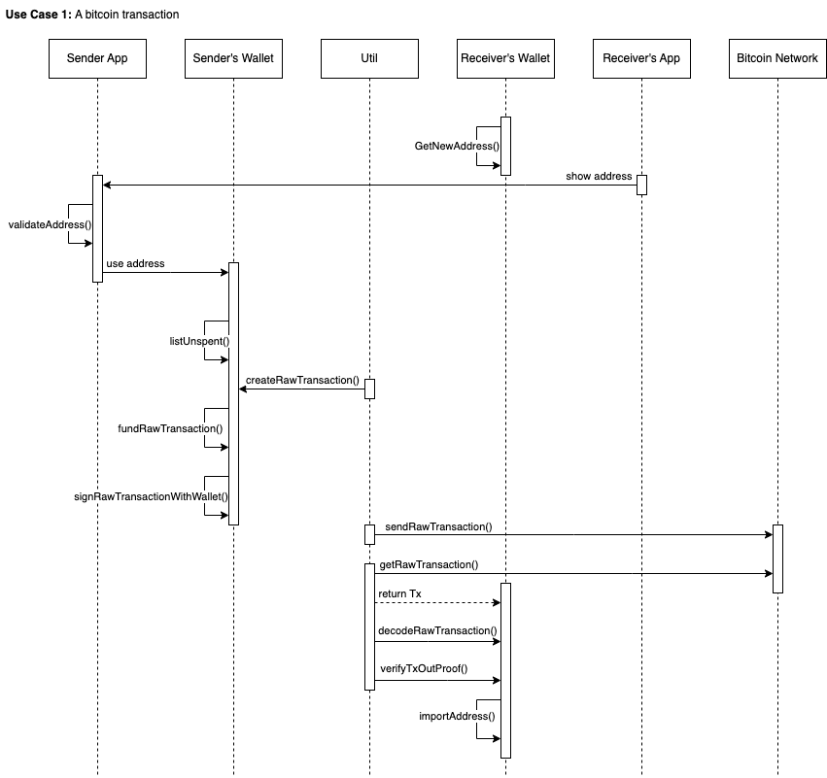

Slide 27
Use Case 2
Bitcoin Mining

Slide 28
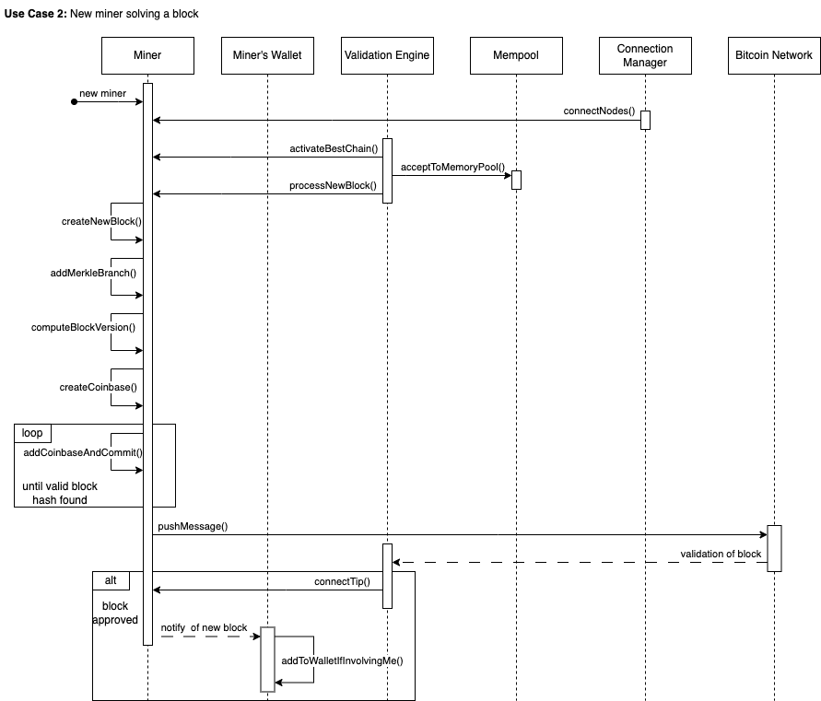

Slide 29
Limitations
& Lessons Learned
Complexity
Modular Approach
Documentation
Testing & Validating
L1
LL1
Complex & intertwined components
Lack of familiarity with Understand
Cross-referenced material
Separation of concerns
Allow change to specific sub-systems
Lessen impact to overall architecture
L2
LL2
Lack of clear documentation
Identify module and file purposes
Significant amount of “Trial & Error”
First try → Nice try 😭
Regular meetings
Persistence, resilience, accuracy

Slide 30
Conclusions
Made use of Online resources, Bitcoin Repository, and Understand software
High-level analyses of eight subsystems and delved deeper into the Mining subsystem’s low-level architecture
The architecture is consistent with our previous report, being a pipe-and-filter architecture, but with notable divergences
Limitations & Lessons, Use cases illustrated with Sequence diagrams
Extremely helpful to fully understand Bitcoin Core’s concrete architecture

